Slide 1

Exploratory Data Analysis of Geeks for Geeks Interview Problems
Presented By :
D. Vishnu Vardhan
Batch - 435

Slide 2



Data-Driven Analysis of Interview Preparation Problems

Slide 3
AGENDA
  BUSINESS PROBLEM
  BUSINESS OBJECTIVE
  INTRODUCTION
  DATA COLLECTION & OVERVIEW
  DATA PREPROCESSING
  EXPLORATORY DATA ANALYSIS
  HYPOTHESIS TESTING
  INSIGHTS
  RECOMMENDATIONS
  CONCLUSION

Slide 4

BUSINESS PROBLEM
  A coaching institute that prepares students for technical and data-related roles faces difficulty in structuring an effective interview preparation curriculum.
  The absence of a data-driven curriculum makes it hard to align training with real interview difficulty and company expectations.
  This leads to inefficient preparation and lower student placement readiness.

Slide 5
BUSINESS OBJECTIVE
  The objective of this project is to analyze interview problems sourced from online coding platforms to identify patterns related to problem difficulty, submission frequency, accuracy, and company association.
  By performing exploratory data analysis on these problems, the coaching institute aims to prioritize high-impact problems, structure difficulty progression, and align its curriculum with real-world interview expectations.

Slide 6
INTRODUCTION
  Online platforms like GeeksforGeeks host thousands of coding and problems used by students for technical interview preparation.
  These problems vary widely in difficulty, success rate, and relevance to real interview scenarios.
  Without analysis, it is difficult to understand practice patterns and learning challenges from such large problem collections.
  This project uses problem-level data to gain insights that support structured and informed interview preparation.

Slide 7
DATA COLLECTION
  The dataset was collected from the GeeksforGeeks Explore – Interview Problems section.
  Selenium was used to load dynamic content, and BeautifulSoup was used to parse and extract structured data from the rendered HTML.
  Each record represents an individual interview problem along with difficulty level, submissions, accuracy, and company tags.
  The final dataset was stored in a structured CSV format for analysis and visualization.

Slide 8
DATASET OVERVIEW
  Problem: Title of the coding or interview problem.
  Difficulty: Difficulty level assigned to the problem (Easy, Medium, Hard).
  Submissions: Total number of times the problem has been attempted on the website.
  Accuracy: Percentage of successful submissions.
  Companies: Companies associated with the problem.

Slide 9
DATA PREPROCESSING
  Removed duplicate problem records to avoid repeated analysis.
  Converted submission counts to numeric by replacing K / M values with numeric equivalents.
  Cleaned accuracy values by removing percentage (%) symbols and converting them to numeric format.
  Merged the single School difficulty problem into Easy due to insufficient sample size.

Slide 10
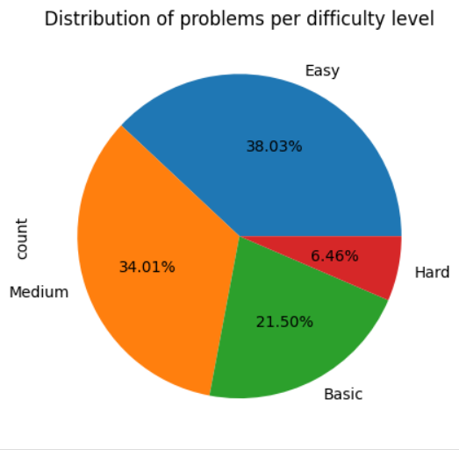

EXPLORATORY DATA ANALYSIS
  There are 1307 easy , 1169 medium , 739 basic and 222 Hard level problems.

Slide 11
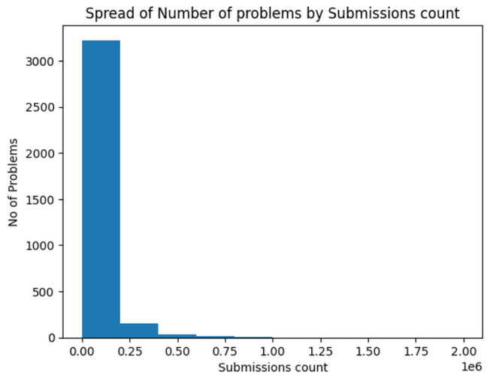
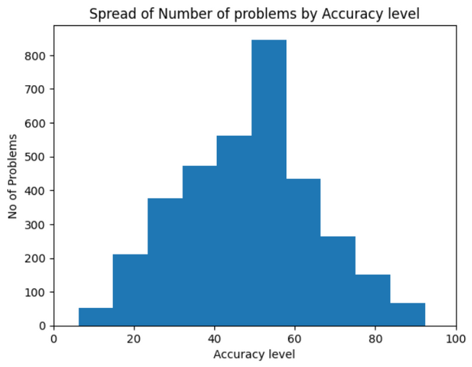
  There are 1307 easy , 1169 medium , 739 basic and 222 Hard level problems.
  Most of the problems have an accuracy in between 30 - 70 % .

Slide 12
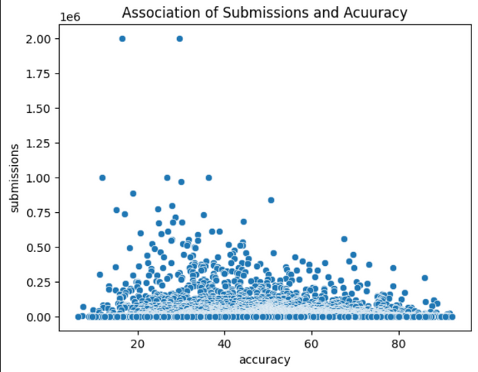
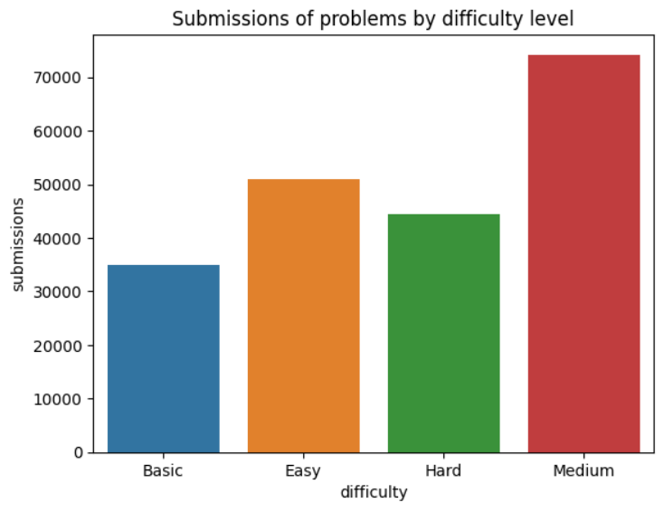
  There is no strong linear relationship between accuracy and number of submissions, indicating that problem popularity is not solely driven by how easy a problem is.
  As the difficulty level increases , the number of submissions also increase and students tend to practise more medium level problems.

Slide 13
HYPOTHESIS TESTING
Null Hypothesis (Ho) : Mean accuracy is the same across all difficulty levels.
Alternate Hypothesis (Ha) : Mean accuracy differs across difficulty levels.
  Test : One - way Anova Test
  confidence level = 0.95
  alpha = 0.05
  p = 4.409 × 10⁻²¹
As p < alpha , The Null Hypothesis (Ho) is rejected.
Hence , The Mean accuracy significantlydiffers across difficulty levels.

Slide 14
INSIGHTS
  Medium-difficulty problems contribute the largest share of student practice, making them the central focus of interview preparation.
  Accuracy consistently decreases as difficulty increases, confirming that harder problems need more guidance.
  Nearly 15% of problems have very low accuracy (<30%), highlighting critical areas where students struggle the most.
  A small number of problems have extremely low accuracy (<10%), making them clear outliers that require special instructional focus.
  Company-tagged problems are mostly concentrated at the Medium difficulty level, indicating that companies emphasize strong intermediate problem-solving skills.
  Company-specific problems have lower average accuracy than general problems, making them more challenging and important for guided preparation.
  Students practice general problems more frequently than company-tagged problems.

Slide 15
RECOMMENDATIONS
  Prioritize medium-difficulty problems as the core of the curriculum, since they drive the highest student practice and align closely with interview expectations.
  Introduce guided instructor-led sessions for problems with high submissions but low accuracy to help students overcome repeated mistakes.
  Create focused learning modules for very low-accuracy problems (<30%) to address critical gaps in student understanding.
  Allocate additional mentoring and practice support for company-specific problems, as they are more challenging and have lower success rates.
  Design company-oriented practice tracks centered around medium-difficulty problems to better prepare students for real interview scenarios.

Slide 16
CONCLUSION
  This project uses data-driven analysis to understand student practice patterns, problem difficulty, accuracy, and company relevance in interview preparation. The results show clear differences in performance and engagement across difficulty levels and company-tagged problems.
  These insights help coaching institutes focus on high-impact problems, address critical learning gaps, and better align training programs with real interview requirements.

Slide 17

ANY
QUERIES?

Slide 18
Thank you

